Slide 2
Essential Matrix
The essential matrix, denoted as E, relates two camera views.
Given a point in one view, P, and the corresponding point in another view, P', the essential matrix satisfies the equation:
P‘^{T} * E * P = 0
The essential matrix has a rank of 2.
It is unique up to scale.
It is a 3x3 matrix.
Camera Calibration:To estimate the essential matrix, it is often necessary to first calibrate the cameras (i.e., determine their intrinsic parameters) or use normalized coordinates. This ensures that the essential matrix can be estimated solely from the geometric relationships between corresponding points.

Slide 3
Epipolar Constraint
The essential matrix enforces the epipolar constraint.
This constraint states that, for any point P in one image, the corresponding point P' in the other image must lie on a line called the epipolar line.

Slide 4
Decomposition: Once the essential matrix E is known, it can be decomposed into its constituent parts: rotation matrix R and translation vector T. This decomposition is known as the Essential Matrix Decomposition. It provides information about how the second camera is positioned and oriented relative to the first camera.

Slide 5
Relationship between Essential Matrix and Fundamental Matrix
Essential Matrix (E): The essential matrix is a 3x3 matrix that relates the poses (rotations and translations) of two calibrated cameras, also known as the "camera motion." It is essential for tasks like stereo vision, camera motion estimation, and 3D reconstruction.
Fundamental Matrix (F): The fundamental matrix is also a 3x3 matrix that describes the epipolar geometry between two images. It encodes the relative positions and orientations of the two cameras and the epipolar constraints that relate corresponding points in the two images.

Slide 6
Calibration:
Essential Matrix (E): The essential matrix is typically derived from calibrated cameras, where the intrinsic parameters (focal length, principal point) are known. This allows for metric reconstruction of 3D points.
Fundamental Matrix (F): The fundamental matrix does not require camera calibration and can be computed from uncalibrated cameras. It only relates the relative geometry of the two cameras and the observed correspondences between points.

Slide 7
Epipolar Constraint:
Both E and F satisfy the epipolar constraint: For a point P in one image, the corresponding point P' in the other image must lie on the epipolar line defined by the equation P'^T * E * P = 0 (or P'^T * F * P = 0 for the fundamental matrix).
The key difference is that E describes the epipolar geometry in metric units (e.g., meters), while F describes it in pixel units. This means that F is scale-independent, making it suitable for uncalibrated cameras.

Slide 8
Decomposition:
The essential matrix (E) can be decomposed into its constituent parts: a rotation matrix (R) and a translation vector (T), often referred to as the "camera motion."
The fundamental matrix (F) does not directly provide information about camera motion or the 3D world scale. It describes only the relative geometry between the two images.

Slide 9
Use Cases:
The essential matrix is primarily used when the goal is 3D reconstruction, camera motion estimation, or calibrated stereo vision.
The fundamental matrix is used when the goal is to establish correspondence between points in two images, particularly when camera calibration is not available.

Slide 10
Normalized 8-point algorithm
The Normalized Eight-Point Algorithm is a fundamental technique in computer vision and photogrammetry for estimating the essential matrix or fundamental matrix that describes the relationship between corresponding points in two images taken by a camera with an unknown focal length and skew.
It is called "normalized" because it operates on normalized coordinates, which means that the image points are preprocessed to eliminate the effects of unknown camera parameters.

Slide 11
Algorithm
Input Corresponding Points: Given a set of corresponding points in two images, collect at least eight pairs of points. Each pair consists of a point in the first image (u, v) and the corresponding point in the second image (u', v').
Normalization: Normalize the coordinates of the points to remove the effects of the unknown camera parameters (focal length, skew, etc.). The normalization process involves the following steps:
Calculate the centroids of the points in both images:
(u_c, v_c) = (sum(u) / n, sum(v) / n)
(u'_c, v'_c) = (sum(u') / n, sum(v') / n)
Calculate the average distance of points from the centroids in both images:
d = sqrt((u - u_c)^2 + (v - v_c)^2)
d' = sqrt((u' - u'_c)^2 + (v' - v'_c)^2)
Scale the points so that the average distance is sqrt(2) (to make them invariant to scaling):
u_normalized = (u - u_c) / d * sqrt(2)
v_normalized = (v - v_c) / d * sqrt(2)
u'_normalized = (u' - u'_c) / d' * sqrt(2)
v'_normalized = (v' - v'_c) / d' * sqrt(2)

Slide 12
Construct the Normalized A Matrix: Build the A matrix, which is used to find the essential matrix, from the normalized coordinates:
A = [u_normalized * u'_normalized, u_normalized * v'_normalized, u_normalized, v_normalized * u'_normalized, v_normalized * v'_normalized, v_normalized, u'_normalized, v'_normalized, 1]
Solve for the Fundamental Matrix: Compute the singular value decomposition (SVD) of the A matrix and extract the right singular vector corresponding to the smallest singular value. This vector represents the elements of the fundamental matrix F.
Enforce Rank-2 Constraint: Set the smallest singular value to zero to ensure that the matrix is rank-2. This step corrects for any noise or numerical inaccuracies.
Denormalization: Transform the estimated fundamental matrix F back to the original image coordinate system. This involves reversing the normalization process applied to the coordinates in step 2.
Optional Refinement: If desired, you can further refine the estimated fundamental matrix using techniques like RANSAC (Random Sample Consensus) to handle outliers or improve accuracy.

Slide 13
Program to estimate essential and Fundamental matrix
import cv2
import numpy as np
# Load the two images
img1 = cv2.imread('image1.jpg', 0)
img2 = cv2.imread('image2.jpg', 0)
# Define corresponding points)
pts1 = np.array([
[100, 200],
[150, 180],
[200, 160],
[250, 140],
[300, 120],
[350, 100],
[400, 80],
[450, 60]
], dtype=np.float32)
pts2 = np.array([
[300, 50],
[350, 70],
[400, 90],
[450, 110],
[500, 130],
[550, 150],
[600, 170],
[650, 190]
], dtype=np.float32)
# Normalize the points
pts1_normalized = cv2.normalize(pts1, None, 0, 1, cv2.NORM_MINMAX)
pts2_normalized = cv2.normalize(pts2, None, 0, 1, cv2.NORM_MINMAX)
# Estimate the essential matrix using the normalized points
F, _ = cv2.findEssentialMat(pts1_normalized, pts2_normalized)
# Print the estimated essential matrix
print("Estimated Essential Matrix:")
print(F)
# Estimate the fundamental matrix using the normalized F, _ = cv2.findFundamentalMat(pts1_normalized, pts2_normalized,)
# Print the estimated fundamental matrix
print("Estimated Fundamental Matrix:")
print(F)

Slide 14
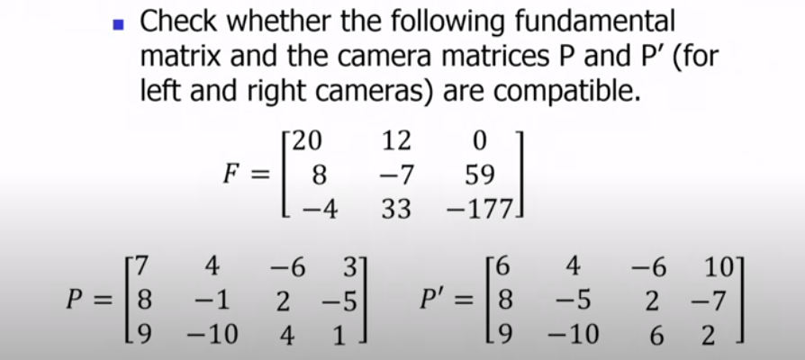

Slide 15
Depth Estimation
Depth estimation in computer vision is the process of determining the distance or depth of objects in a scene from one or more images or sensor data.
Accurate depth estimation is crucial for various applications, including autonomous navigation, 3D reconstruction, augmented reality, and object recognition.
Estimating depth in stereo vision involves calculating the disparity between corresponding points in the left and right images captured by a stereo camera setup.

Slide 16
Disparity
Disparity refers to the difference or gap between two things.
In the context of computer vision, "disparity" specifically refers to the perceived difference in the horizontal position of an object or feature in the visual field when viewed by each eye in a stereo vision system.
This term is closely related to stereo vision, which is the process of estimating depth and three-dimensional (3D) information from the disparity between the views of two or more cameras or images.
When you have multiple images of the same scene taken from slightly different viewpoints, the differences in the positions of corresponding points in these images are used to calculate disparity.
The greater the disparity for a point, the closer it is to the camera(s)

Slide 17
Disparity Map: A disparity map is a visual representation of the disparities between corresponding points in stereo images. Brighter regions in the map correspond to objects that are closer to the cameras, while darker regions correspond to objects that are farther away.
Stereo Vision: Stereo vision systems utilize the concept of disparity to estimate depth information and construct 3D representations of scenes. These systems use pairs of images from stereo cameras or multiple viewpoints to calculate disparities and infer depth.
Depth Estimation: Disparity information is used to estimate the relative depth of objects within a scene. By triangulating the disparities, you can calculate the distances of objects from the cameras, allowing for 3D reconstruction.

Slide 18
Depth Calculation
Using the disparity map and calibration parameters, you can calculate depth for each pixel. The basic formula for depth (Z) calculation is:
Z = (baseline * focal_length) / disparity

Slide 19
Numerical 1
Suppose you have a stereo camera setup with the following parameters:
Baseline (B): 0.1 meters (10 centimeters) - This is the distance between the two camera centers.
Focal Length (f): 0.01 meters (10 millimeters) - The focal length of both cameras.
Disparity (d): 20 pixels - The disparity value for a specific point in the left and right images.
Z = (0.1 meters * 0.01 meters) / 20 pixels
Z = (0.001 square meters) / 20 pixels
Z = 0.00005 meters

Slide 20
Numerical 2
We have a stereo camera setup with known parameters.
The baseline between the two cameras is 10 centimeters.
The focal length of both cameras is 500 pixels.
We've matched a feature in the left and right images, and we've calculated a disparity of 20 pixels for that feature.
Z = (0.1 meters * 500) / 20
Z = 5 meters

Slide 21
Linear Triangulation Method
Linear triangulation is a method used in computer vision and 3D computer graphics to estimate the 3D coordinates of a point in space using two or more 2D projections of that point from different viewpoints (cameras).
This technique assumes that you have calibrated cameras with known parameters and that you can find corresponding points in the camera images.
Assumptions and Prerequisites:
Calibrated Cameras: The intrinsic parameters (focal length, principal point, etc.) of the cameras are known, and they are properly calibrated.
Corresponding Points: You have identified corresponding points in two or more images taken from different camera viewpoints. These points correspond to the same 3D point in the scene.

Slide 22
Steps for Linear Triangulation
Image Projection:
For each camera, you need to project the 3D point onto the image plane to get 2D image coordinates.
Use the camera's intrinsic matrix (K) and extrinsic matrix (R and t) for this projection. The intrinsic matrix describes the internal camera parameters, while the extrinsic matrix describes the camera's position and orientation in the world.
P1 = K1 * [R1 | t1] # Projection matrix for camera 1
P2 = K2 * [R2 | t2] # Projection matrix for camera 2
Homogeneous Coordinates: Convert the 2D image coordinates and projection matrices into homogeneous coordinates. Homogeneous coordinates include an extra dimension (usually 1) that allows for more convenient matrix operations.
X1 = [x1, y1, 1]
X2 = [x2, y2, 1]

Slide 23
Linear Equation: Set up a linear equation system based on the relationship between 3D coordinates and their projections:
X1 = P1 * X # Projection equation for camera 1
X2 = P2 * X # Projection equation for camera 2
Here, X represents the 3D coordinates of the point you want to triangulate.
Solve Linear Equation:
Formulate the linear equation system for the 3D point X.
Typically, you would set up an overdetermined system with more equations than unknowns, and then use techniques like least squares or singular value decomposition (SVD) to find the best 3D point that satisfies all equations.
Triangulated Point: Once you've solved the linear equations, you obtain the 3D coordinates of the point X in the world coordinate system. These are the estimated coordinates of the point you are triangulating.

Slide 24
Example
Camera 1 Parameters:
Intrinsic Matrix (K1):
| 500 0 320 |
| 0 500 240 |
| 0 0 1 |
Extrinsic Matrix (R1, t1):
R1 = Identity matrix (no rotation)
t1 = [0, 0, 0] (camera at the origin)
Camera 2 Parameters:
Intrinsic Matrix (K2): same as camera 1
Extrinsic Matrix (R2, t2):
R2 = Rotation matrix (e.g., 45 degrees around the z-axis)
t2 = [1, 0, 0] (camera shifted 1 meter along the x-axis)
2D Image Coordinates (in pixels):
Camera 1 (x1, y1) = (300, 200)
Camera 2 (x2, y2) = (250, 250)

Slide 25
Projection:
Calculate the projection matrices for both cameras:
P1 = K1 * [R1 | t1]
P2 = K2 * [R2 | t2]
Homogeneous Coordinates:
Convert the 2D image coordinates into homogeneous coordinates:
X1 = [x1, y1, 1]
X2 = [x2, y2, 1]
Linear Equation:
Set up the linear equation system using the projection equations:
X1 = P1 * X
X2 = P2 * X
In matrix form:
[x1] [ P1(1,:) ] [X]
[y1] = [ P1(2,:) ] * [Y]
[1 ] [ P1(3,:) ] [Z]
Similarly for Camera 2.
Solve Linear Equation

Slide 26
Program
import cv2
import numpy as np
# Load calibration matrices (K and distortion coefficients) for both cameras
K1 = np.array([[500, 0, 320], [0, 500, 240], [0, 0, 1]]) # Intrinsic matrix for camera 1
K2 = np.array([[500, 0, 320], [0, 500, 240], [0, 0, 1]]) # Intrinsic matrix for camera 2
# Define the projection matrices for both cameras (including rotation and translation)
P1 = np.hstack((K1, np.zeros((3, 1)))) # Projection matrix for camera 1
R2 = np.array([[1, 0, 0], [0, 1, 0], [0, 0, 1]]) # Identity rotation matrix (no rotation)
t2 = np.array([[1], [0], [0]]) # Translation for camera 2 (1 meter along the x-axis)
P2 = np.hstack((K2, t2)) # Projection matrix for camera 2
# 2D image coordinates for the point in both images
x1 = np.array([300, 200]) # Image coordinates in camera 1
x2 = np.array([250, 250]) # Image coordinates in camera 2
# Linear triangulation
X_homogeneous = cv2.triangulatePoints(P1, P2, x1, x2)
# Convert homogeneous coordinates to 3D coordinates
X_cartesian = X_homogeneous[:3] / X_homogeneous[3]
# Print the estimated 3D coordinates
print("Estimated 3D Coordinates (X, Y, Z):", X_cartesian)
# Display the estimated 3D point
print("Estimated 3D Point:", X_cartesian.ravel())

Slide 27
Geometric Error Cost Function
A geometric error cost function is used to quantify the difference between observed (measured) geometric relationships and the relationships predicted by a model or estimated parameters.
The goal is to minimize this cost function to improve the accuracy of geometric reconstructions.
In geometric computer vision, a typical geometric error cost function can be defined as follows:
E(parameters) = Σ(w * f(observed, predicted, parameters)^2)
E(parameters): The error cost function that depends on a set of parameters to be optimized.
w: Weighting factor or vector, which assigns different importance to individual geometric constraints or observations. It is used to emphasize or de-emphasize specific constraints based on their reliability or importance.
f(observed, predicted, parameters): The geometric constraint or observation function that computes the difference between the observed (measured) values and the values predicted by the model or the current estimate of parameters.

Slide 28
Examples of Geometric Error Cost Functions
Reprojection Error: In structure-from-motion (SfM) or camera pose estimation, one common geometric error is the reprojection error. Given 3D points, camera parameters, and their corresponding 2D image observations, the cost function can be the squared Euclidean distance between the projected 3D point in the image plane and the observed 2D point.
Epipolar Constraint Error: In stereo vision or multi-view geometry, the epipolar constraint error measures the consistency of epipolar lines between two views. It ensures that a point in one image lies on the epipolar line of its corresponding point in the other image. The cost function may involve the distance between the observed point and the epipolar line.
Fundamental Matrix Error: In the context of fundamental matrix estimation, the cost function measures how well the estimated fundamental matrix satisfies the epipolar constraint for a set of point correspondences between two images.
Homography Error: For planar scenes or when estimating the transformation between images, the homography error measures the difference between the observed and predicted positions of points transformed by the estimated homography matrix.

Slide 29
Algebraic Minimization Algorithm
Algebraic minimization algorithms, often referred to as algebraic solvers or direct linear methods, are used in computer vision and photogrammetry to estimate the parameters of a geometric or photometric model by directly solving a system of algebraic equations.
These methods are suitable for problems with known or well-structured models and have the advantage of being relatively fast and deterministic.
Homography Estimation:
Homography estimation is used for planar object recognition and image stitching.
It involves finding a homography matrix that maps points from one image to another (e.g., transformation between two planar images).
The Direct Linear Transform (DLT) method is often used to estimate the homography matrix.

Slide 30
Essential Matrix Estimation:
The essential matrix is a fundamental matrix in stereo vision, used to relate corresponding points between two views.
Algebraic solvers can be used to estimate the essential matrix from a set of point correspondences.
Fundamental Matrix Estimation:
The fundamental matrix describes the epipolar geometry between two views and is used in stereo vision and structure-from-motion.
Algebraic methods are used to estimate the fundamental matrix from point correspondences.

Slide 31
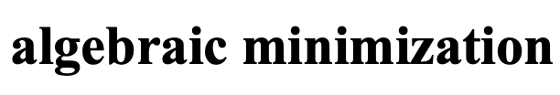
The singularity constraint
detF = 0 rank F = 2
SVD from linearly computed F matrix (rank 3)
⎡σ₁
⎤
⎥
F = U⎢ σ
T T
V = U σ V + U σ V^{T} + U σ V^{T}
⎢
2
_{σ} ⎥
1 1 1 2 2 2 3 3 3
⎣
min F- F'
3 ⎦
F
Compute closest rank-2 approximation
⎡σ₁
⎤
⎥
F'= U⎢ σ
T T
V = U σ V + U σ V^{T}
⎢
2
₀⎥
1 1 1 2 2 2
⎣
⎦

Slide 32
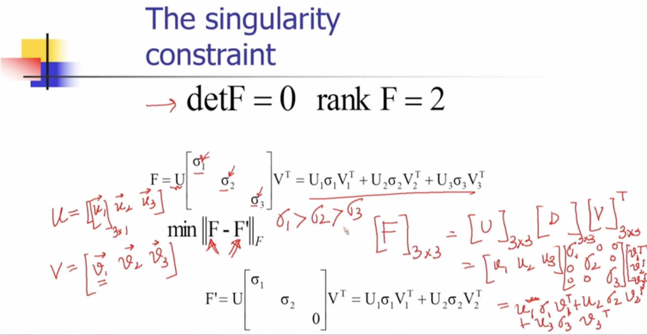

Slide 33
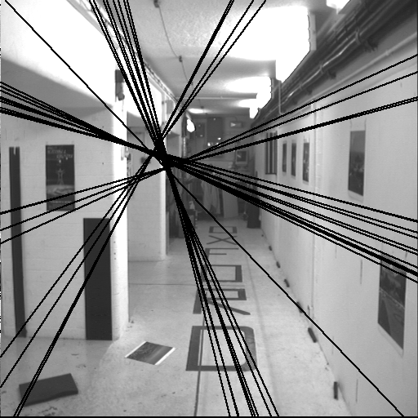
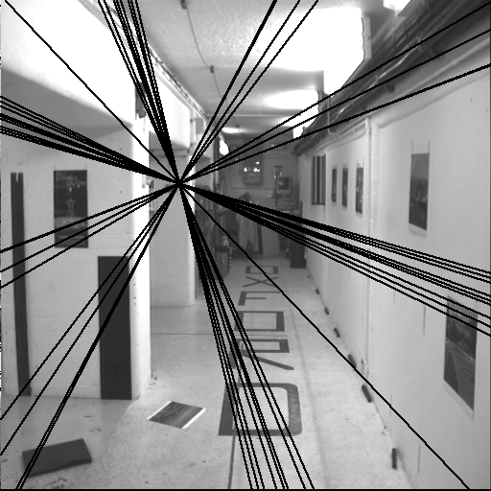
The singularity constraint
Singular F
Nonsingular F
Non-singular F causes epipolar lines not converging.
From Hartley and Zisserman, “Multiple view geometry in computer vision”, Cambridge Univ. Press (2000)

Slide 34
Geometric distance
This section describe ways minimize a geometric image distance.
Parametrization of rank-2 matrices:
The non-linear minimization of the geometric distance cost functions requires a parametrization of the fundamental matrix which enforces the rank 2 property of the matrix.

Slide 35
There are a number of ways to parametrize the fundamental matrix.
One way is to over-parameterize it, which means that we use more parameters than are strictly necessary. This is often done by writing the fundamental matrix as the product of a non-singular matrix and a skew-symmetric matrix.
Another way to parametrize the fundamental matrix is to use the epipolar parametrization. This parametrization specifies the first two columns of the fundamental matrix, along with two multipliers α and β such that the third column can be written as a linear combination of the first two columns.

Slide 36
Finally, the both epipoles as parameters parametrization specifies both epipoles as parameters. This parametrization is more general than the epipolar parametrization, but it is also more complex.

Slide 37
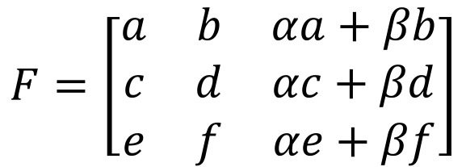



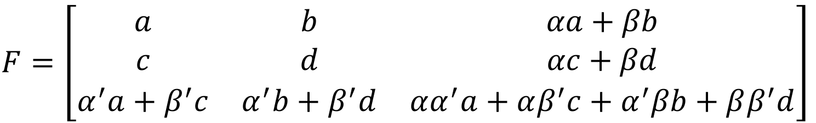


Parametric representation of F
X
x
l’
x’
l
C e’
P
C’
P’
e
Over parameterization: F=[t]_{x}M ➔ {t,M} → 12 params. Epipolar parameterization:
Left epipole
Both epipoles as parameters
Epipoles

Slide 38
Experimental evaluation of the algorithms
Algorithms Being Compared:
Algorithm 1: The normalized 8-point algorithm
Algorithm 2: Minimization of algebraic error with the singularity constraint.
Algorithm 3: Geometric distance algorithm

Slide 39
Experimental Setup:
For each pair of images, you randomly select a number of matched points. Let's call this number "n.”
Fundamental Matrix Estimation:
Using the selected "n" matched points, you estimate the fundamental matrix for each algorithm.
Residual Error Calculation:
After estimating the fundamental matrix, you calculate a residual error. This error likely represents how well the estimated fundamental matrix aligns with the actual point correspondences in the image pair.

Slide 40
Repetition:
This entire process is repeated 100 times for each value of "n" and for each pair of images. So, you're conducting 100 trials for different combinations of "n" and image pairs.
Data Collection:
For each combination of "n" and image pair, you collect the average residual error. This will give you a dataset of average residual errors for each algorithm at various values of "n.”
Plotting:
Finally, you plot the average residual error against the number of matched points "n." This helps you visualize how the different algorithms perform as the number of points increases. It can show which algorithm is more robust or accurate as the data becomes more abundant.

Slide 41
Range of Points "n":
The number of points "n" used ranges from 8 (the minimum) up to three-quarters of the total number of matched points. This means you're evaluating the algorithms at different levels of data complexity, from a small subset of points to a substantial portion of the available points.
Overall, this experimental procedure allows you to compare the performance of the three algorithms under different conditions, providing insights into how they behave as the quantity of input data (number of matched points) varies.
This type of analysis is valuable for selecting the most suitable algorithm for a particular computer vision task based on the available data and the desired level of accuracy.

